Slide 1
Causality
Part 2: Sufficient-cause model and Bradford-Hill

Slide 2
Lecture Outline
Basic concepts/definitions
Causal types
4 causal models
Sufficient-component cause model
Bradford-Hill’s viewpoints
Counterfactual (potential outcomes) model
Directed acyclic graphs (DAGs)

Slide 3
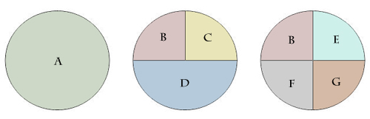
Sufficient-component cause model (Rothman’s Causal Pie Model)
Theoretical mechanistic model
Each pie represents a sufficient causal mechanism
A sufficient causal model represents a minimal set of conditions or events that are sufficient for the outcome to occur
Acknowledges the multifactorial etiology of health outcomes
Notes:
A sufficient cause is a complete causal mechanism; a minimal set of conditions and events that are sufficient for the outcome to occur.

Slide 4
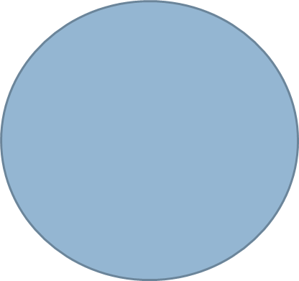
Sufficient-component cause model
A.
B.
C.
Poor Nutrition
N=1
AIDS
A=1
Exposure to TB
T=1
Exposure to TB
T=1
Exposure to TB
T=1
Unknown
U
Poor Nutrition
N=1
Crowded
Housing
C=1
Figure. Hypothetical sufficient cause models for tuberculosis (TB) infection. U represents unknown causal components. The presence of each causal component implies that their absence (e.g., T=0) would block occurrence of the outcome.

Slide 5
Definitions
Component Cause:
An event or condition that plays a necessary role in the occurrence of some cases of a given disease
A.
B.
C.
Poor Nutrition
N=1
AIDS
A=1
Exposure to TB
T=1
Exposure to TB
T=1
Exposure to TB
T=1
Unknown
U
Poor Nutrition
N=1
Crowded
Housing
C=1

Slide 6
Definitions
Necessary Cause:
An event or condition that plays a necessary role in the occurrence of all cases of a given disease; must be present for the disease to occur.
A.
B.
C.
Poor Nutrition
N=1
AIDS
A=1
Exposure to TB
T=1
Exposure to TB
T=1
Exposure to TB
T=1
Unknown
U
Poor Nutrition
N=1
Crowded
Housing
C=1

Slide 7
Definitions
Causal Complement:
The other factors which are necessary and sufficient condition for a factor to produce disease
A.
B.
C.
Poor Nutrition
N=1
AIDS
A=1
Exposure to TB
T=1
Exposure to TB
T=1
Exposure to TB
T=1
Unknown
U
Poor Nutrition
N=1
Crowded
Housing
C=1

Slide 8
Benefits of sufficient-cause model
Helps us to understand:
Multifactorial nature of disease causation
That there is often an unknown (U) contribution to disease causation
The composition of U may vary between people/populations
The fraction of a given disease attributable to its component causes often sums to >100%
This is due to the multifactorial nature of disease etiology
Notes:
For example, consider that 75% of cardiovascular disease is caused by three component causes high cholesterol, high blood pressure, and smoking. We do not know the nature of the other unknown sufficient causes, which may be assumed to account for the other 25% of cardiovascular disease cases. However, the use of causal pies lets us see that there may be unknown component causes, which may add up in different ways with the known component causes to produce the sufficient set of causes for cardiovascular disease. Interventions that target the unknown causes, once they become known in the future, may reduce the disease burden by more than 25%. It is important to remember that, given enough causal agents, the upper limit of which is unknown for any given disease, the attributable fractions would sum to more than 100%. Only the fraction of disease attributable to a single component cause cannot exceed 100%.

Slide 9
Criticisms of sufficient-cause model
More useful on a conceptual basis than in application
Does not depict:
Sequential mechanisms (timing of causal components)
Direct vs. indirect effects of component causes

Slide 10
Bradford-Hill’s Viewpoints
Strength of Association
Consistency
Specificity
Temporality
Biological gradient (dose-response relationship)
Plausibility
Coherence
Experimental evidence
Analogy

Slide 11
Strength of Association
The stronger the association the more likely that the relationship is causal (not representing bias or error)
Observation of a weak observation (RR<~2.0) does not negate the possibility of causality

Slide 12
Consistency
Repeated observation of an association in different populations under different circumstances
Consistency of results across epidemiologic studies gets at the heart of inductive reasoning and is used to infer causality in observational studies
Should be viewed cautiously, as it may just reflect consistency of confounding or bias across studies
Also, may result from publication bias whereby “positive” results are more likely to be published
Notes:
It is sometimes claimed in the literature that results are inconsistent just because some are statistically significant and some are not. The effect estimates may be essentially the same, the difference in significance is solely arising from differences in standard errors or sizes of the studies.

Slide 13
Reasons why true causal associations may not appear consistent
Differences in the specific circumstances of the exposure
Differences in the timing of the study with regard to the exposure’s latency period
Differences in the design and analytic strategies
Differences in the distribution of a causal component
Differences in the stage of the natural history underlying the process
Differences in the effectiveness of interventions
Differences in the variability of a risk factor
Notes:
Think about causal pies….other factors may be different…

Slide 14
Specificity
Cause leads to a single effect, not multiple effects
This criteria is INVALID

Slide 15
Temporality
Exposure must precede the onset of disease
Essential for causation
Can be difficult to establish temporality
Exposure
(e.g. poor childhood nutrition)
Outcome:
(e.g. rate of cognitive aging)
Time

Slide 16
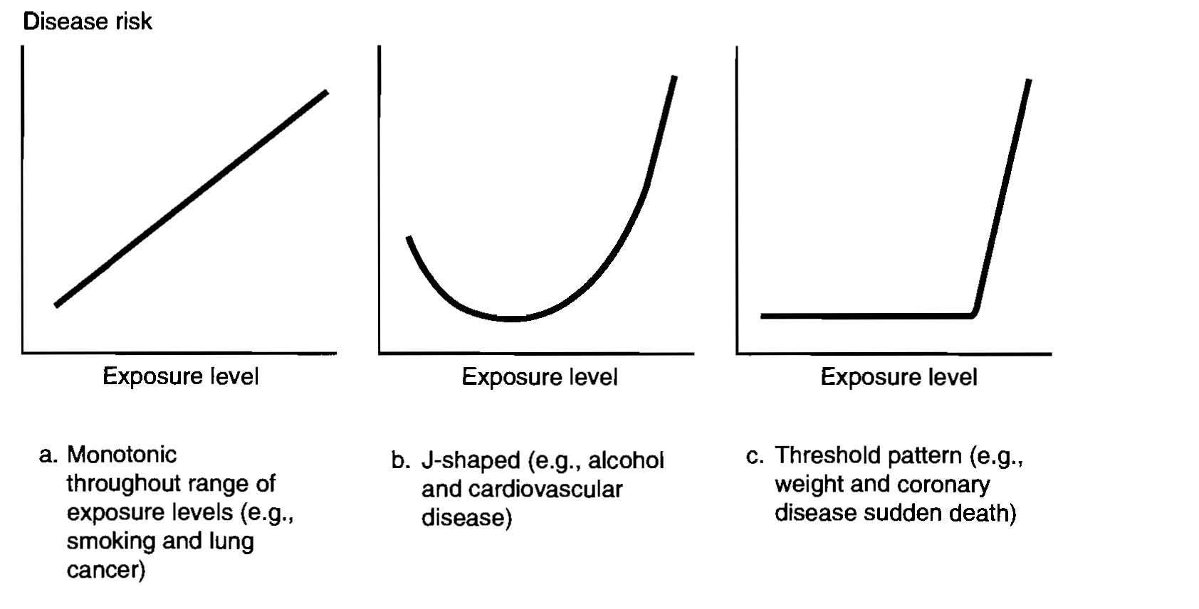
Biological gradient (dose-response)
Relationship between magnitude (dose) of exposure and risk of outcome is regarded as strong evidence
Szklo: Epidemiology Beyond the Basics

Slide 17
Plausibility
A scientifically plausible mechanism between exposure and outcome is helpful
Should be some biological rationale
Hill noted that knowledge of the mechanism is limited by the current state of evidence
Plausibility can change with time as knowledge grows
Notes:
Baysian approach to inference attempts to deal with this problem by requiring that one quantify, on a probability (0 to 1) scale, the certainty that one has in prior beliefs

Slide 18
Coherence
Implies a cause-and-effect interpretation for an association does not conflict with what is known of the natural history and biology of disease
Notes:
Fine line between the difference in criteria for coherence and plausibility—coherence is the PRESENCE OR ABSENCE of conflicting information

Slide 19
Experimental Evidence
Laboratory experiments in animals or humans
Often not ethical or possible to randomly assign exposures – we can’t always get experimental data
Notes:
Really a test of the causal hypothesis.

Slide 20
Analogy
The effect of similar factors may be considered
Not a useful criterion

Slide 21
End of Part 2
Next is:
Part 3: Potential outcomes and DAGs (Zoom lecture)
Thursday, Sept. 3rd, 10:30-12:00

